Slide 1
Commuter Benefits (CBP)
Presented by Benefit Resource (BRI)
Notes:
During this presentation we will cover the details of Commuter Benefit Plans – specifically, the Beniversal Commute offered by Benefit Resource.

Slide 2
What is a Commuter Benefit Plan?
Tax-free account for workplace commute
enacted through the Clean Air Act in 1998.
(including mass transit
& parking expenses)
Save
30 – 40%*
on mass transit & parking expenses
*Savings vary based on tax bracket.
To see the current limits, visit BenefitResource.com/resources/plan-limits
Notes:
A Commuter Benefit Plan is used for workplace commuting expenses. These tax-free employee benefit accounts typically save participants an average of 30 to 40% on eligible mass transit and parking expenses.
The monthly tax-free limits under a Commuter Benefit Plan are determined by the IRS. You can elect up to the IRS monthly pre-tax maximum for each account, and funds cannot be transferred between a Parking and Mass Transit account. You can find the current limits on the Plan Limits page at BenefitResource.com. Next, let's walk through an actual example of the potential savings you could receive by enrolling in a commuter benefit plan account.

Slide 3
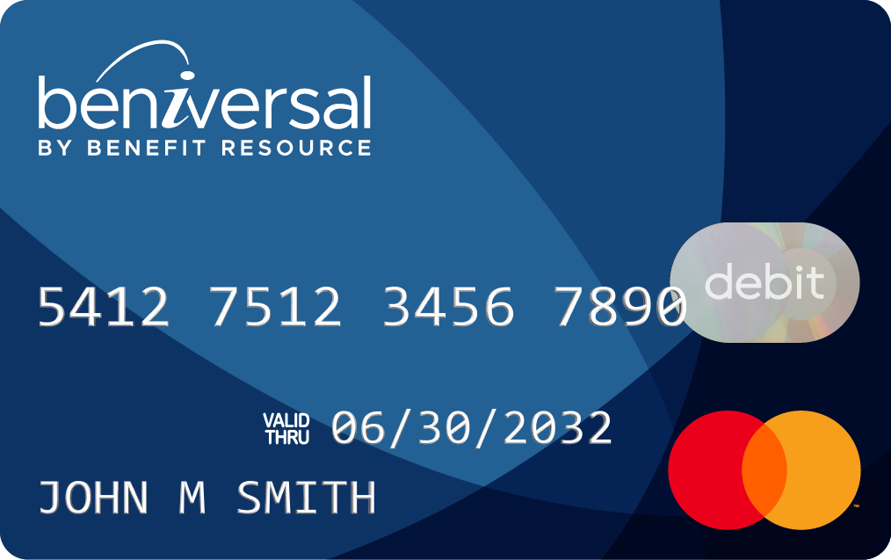
The Tax Savings
Jack and Jane both need $120 per month to cover their commuting expenses.
Jack doesn’t have a pre-tax commuter benefits account.
Jane contributes to her Beniversal pre-tax commuter benefits account.
Jack
INCOME NEEDED: $162
Jane
INCOME NEEDED: $120
Jane saves $42.00 a month or $504.00 a year*
*Assumes 35% combined Federal, State & FICA tax rate. Actual savings may vary.
Notes:
Let’s say Jack and Jane both need 120 dollars per month to cover the cost of their workplace commuting expenses. Jack doesn’t have a pre-tax account. He will need to earn 162 dollars in gross wages to receive a net income of 120 dollars. Jane has a Beniversal Commute account and needs to earn just 120 dollars. On a monthly basis, Jane saves 42 dollars. That’s an annual savings of over 500 dollars!

Slide 4
Eligible Expenses
Eligible workplace transportation expenses include:
Buses
Ferries
Trains & Subways
Qualified Vanpools
Ineligible expenses include the following:
Taxis
Carpools (Uber/Lyft)
Telecommuting
Fuel
Tolls
Eligible workplace parking expenses include:
Parking at/near your workplace
Parking at/near a mass transit location
P
For additional information on what’s eligible, visit BenefitResource.com/resources/eligible
Notes:
But not all workplace commuting expenses can be covered by a Commuter Benefit Plan. So let’s take a look at what is and what isn’t eligible.
The transportation benefit account, sometimes referred to as a mass transit account, can be used for buses, ferries, trains, subways, and vanpools that meet IRS requirements.
The parking benefit account, can be used for parking at or near your workplace. It can also be used at or near a parking location where you pick-up another form of transportation (like a bus station or a park-n-ride )
You cannot use your pre-tax mass transit or parking Commuter Benefit accounts for things like taxis, carpools, telecommuting, fuel, or tolls.

Slide 5
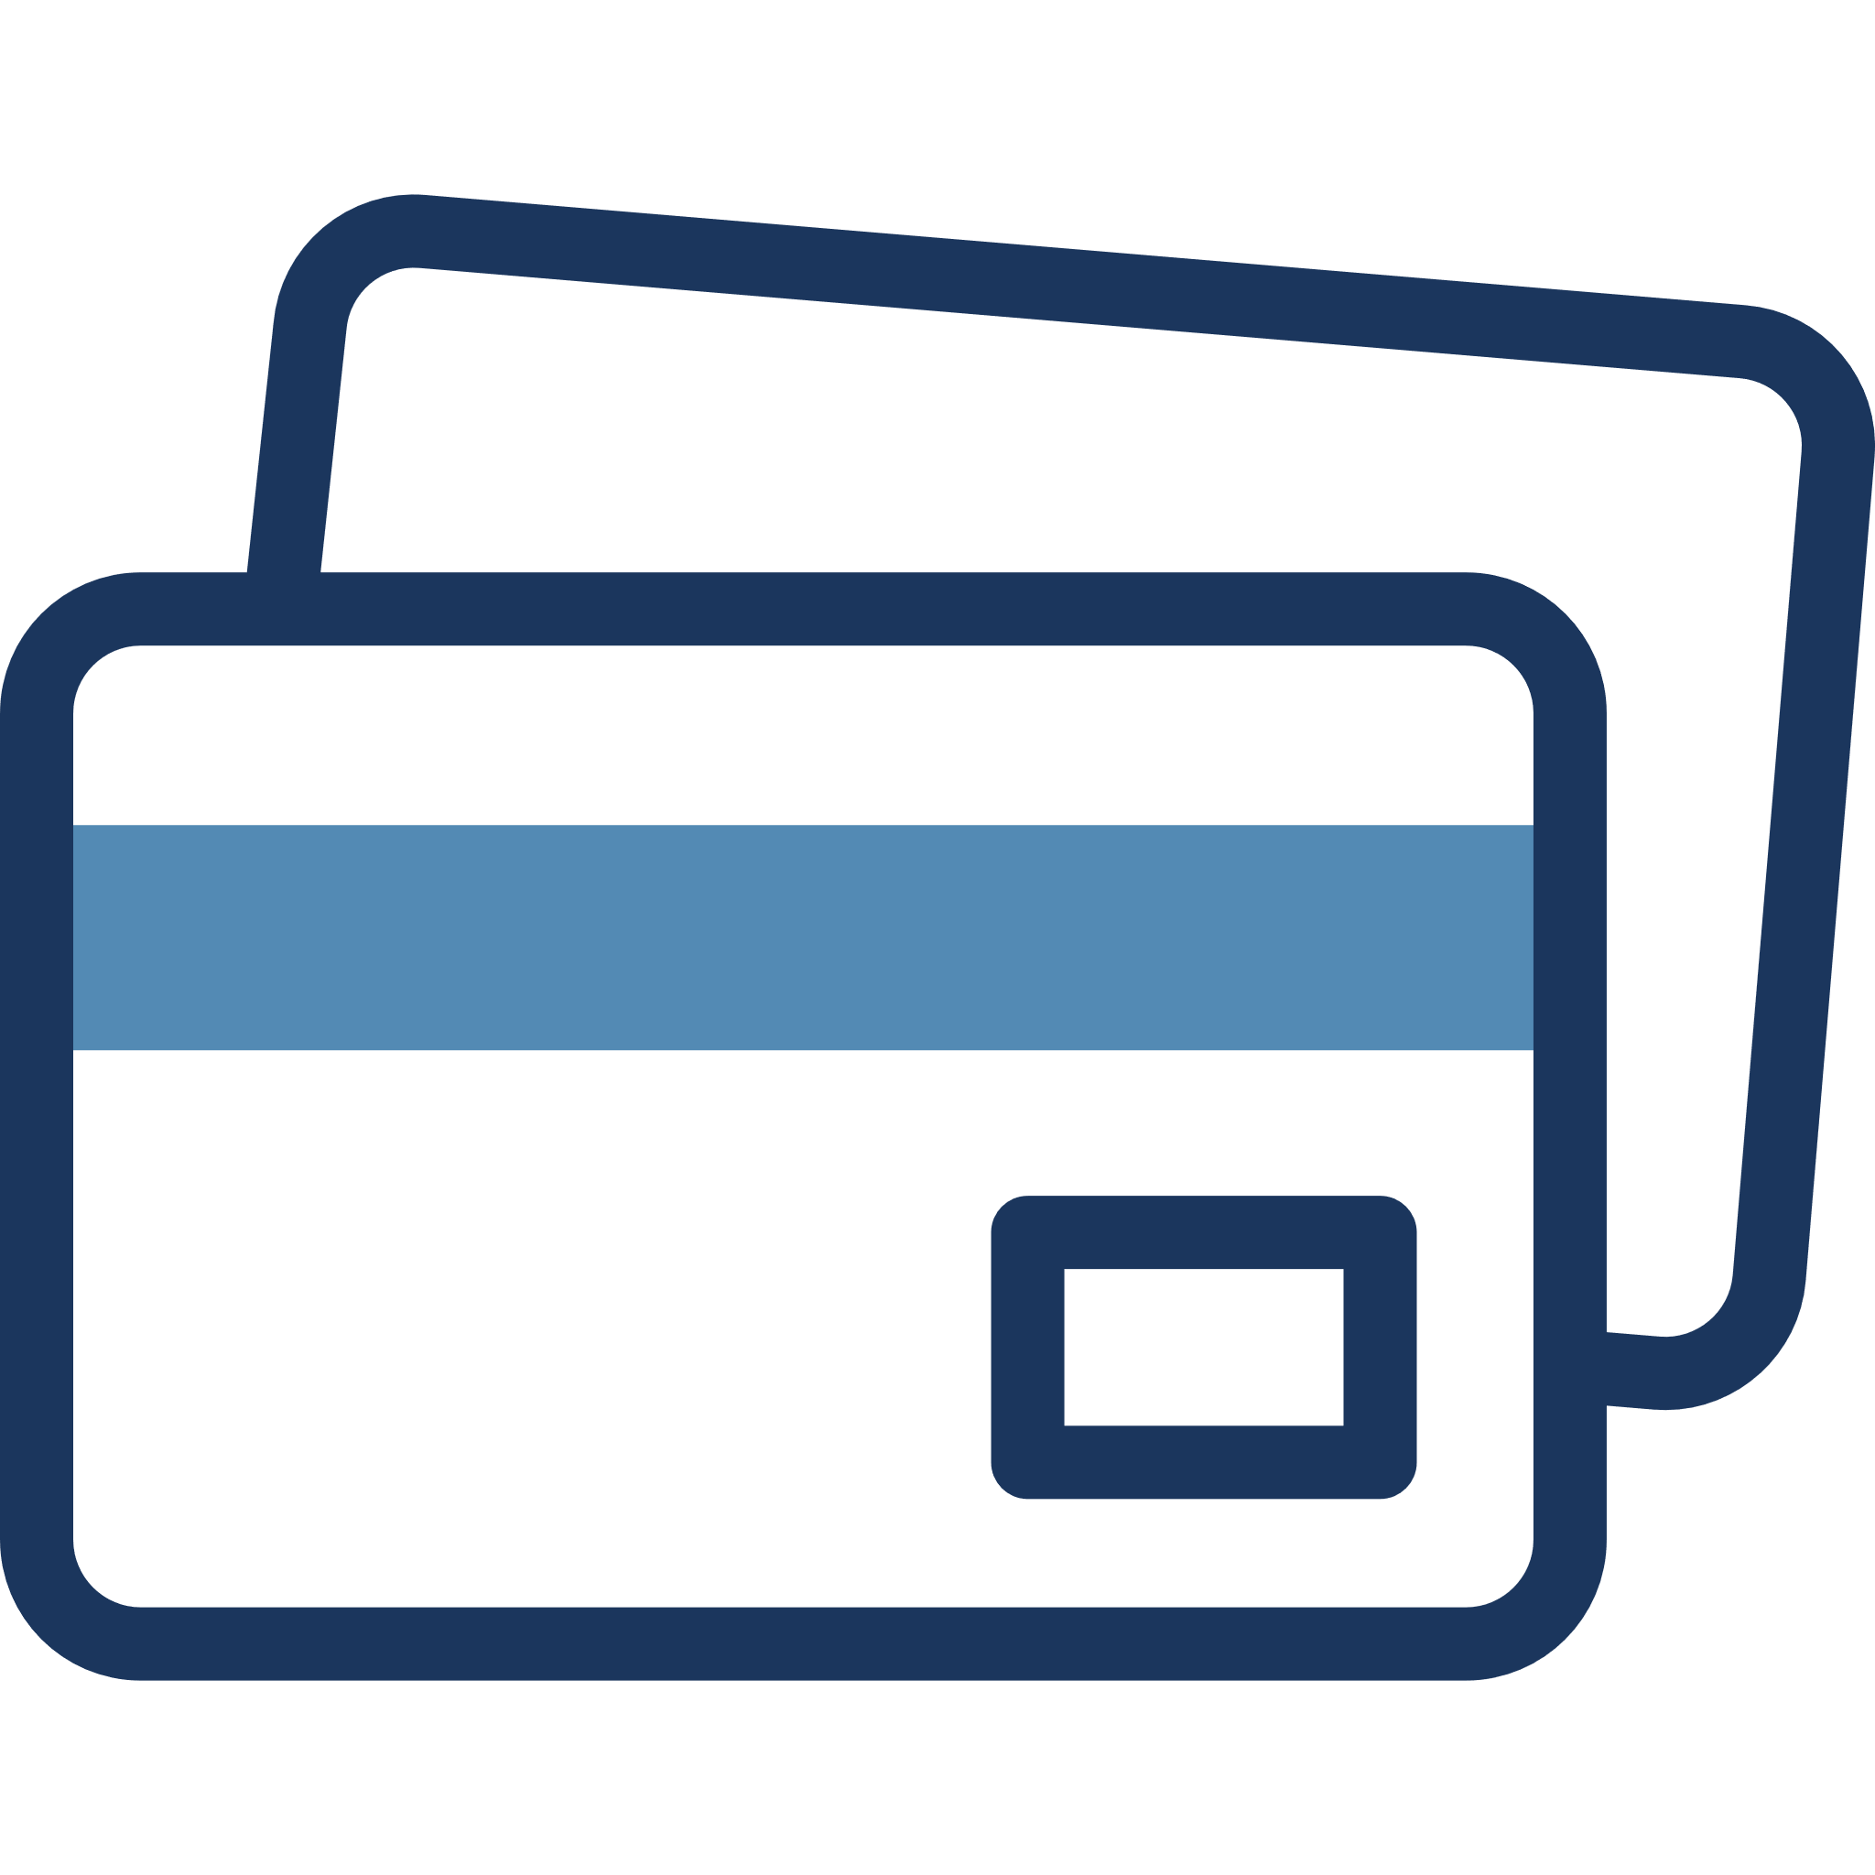
How it Works
Step 1
Sign up for a Beniversal Commute account through your employer.
Step 2
Your election will be deducted from your paycheck by your employer.
Step 3
Receive the Beniversal® (or eTrac ®) Prepaid Mastercard ® in the mail.
Step 4
Use your card for workplace commuting expenses.
Notes:
Now let's dive a little deeper into the details of how a Commuter Benefit Plan works. First, you sign up for the account through your employer. Then your employer begins deducting your election from your payroll. Your Beniversal or eTrac Prepaid Mastercard will arrive by mail. Once you activate it by calling the number on the activation label or by activating it through BRIWEB, you can start charging your workplace commuting expenses to your card.

Slide 6
Using Your Card
The Beniversal/eTrac Prepaid Mastercards provide the ultimate flexibility in purchasing mass transit and parking.
Can be used at any approved mass transit and parking vendors that accept Debit Mastercard
Unused balances carry over every month
Purchases limited to card balance
Report a lost/stolen card immediately
Notes:
Providing you with the ultimate flexibility when making mass transit or parking purchases, Benefit Resource offers the Beniversal and eTrac Prepaid Mastercard. Your card can be used at any approved mass transit or parking vendors that accept Debit Mastercard.
With a Commuter Benefit Plan, unused balances carry over every month. Also keep in mind that the Commuter Benefit Plan is a cash balance account. This means that the amount you can spend is limited to the card balance. And as a reminder always be sure to report lost or stolen cards immediately.

Slide 7
Using Your Card
Use the Beniversal/eTrac Card to purchase or reload
a mass transit pass.
Purchase a new transit card at a transit vending machine or ticket counter.
Link the Beniversal/eTrac Card to an existing card through an online reload program.
Notes:
Next let’s learn about the different ways you can use your Beniversal or eTrac card. One of the most common ways to use the card for commuter benefits is to purchase new Transit cards at a Transit vending machine or directly at a ticket counter.
If you currently use a reloadable card program, the Beniversal or eTrac card can be linked to the program as if it were a personal debit or credit card. When your card reloads, funds will be pulled directly from your Beniversal or eTrac card.

Slide 8
Using Your Card
Use the Beniversal/eTrac Card to purchase tickets online.
Many transportation options allow you to purchase your tickets online. Simply use the Beniversal/eTrac Card to complete your purchases.
Notes:
Additionally, many Transportation providers will allow you to purchase your tickets online. For these vendors, you will simply use your Beniversal or eTrac card number to complete your purchase.

Slide 9
Using Your Card
Enroll in a mail-and-ride program with your Beniversal/eTrac Card as the payment source.
Select the fare you would like to purchase and have passes automatically mailed to you each month. Beniversal/eTrac Card will be debited for the amount of the purchase.
Notes:
You can also use your Beniversal or eTrac card as a source of payment for enrolling in a mail-and-ride program where your passes are automatically mailed to you. Once you select your fare type, link your card to your account and it will be debited for each purchase.

Slide 10
Using Your Card
Using the Beniversal/eTrac Card for other mass transit and parking expenses:
The Beniversal/eTrac Card can be used at point-of-sale to pay for eligible mass transit and parking expenses at qualified merchants accepting Debit Mastercard.
Simply swipe the card and you are on your way to savings. The Beniversal/eTrac Card also works for metered parking that accepts Debit Mastercard.
If billed for monthly parking and provided with a debit/credit option, use your Beniversal/eTrac Card number to pay the expense.
Notes:
Your card can also be used for other mass transit or parking expenses. Your card can be used in general to pay for eligible workplace mass transit and parking expenses at the point of sale from qualified merchants who accept Debit Mastercard.
You can use your card for metered parking as long as Debit Mastercard is accepted or for parking reserved through SpotHero. And if you're billed monthly for parking, you can always provide your Beniversal or eTrac card number to cover the expense.

Slide 11
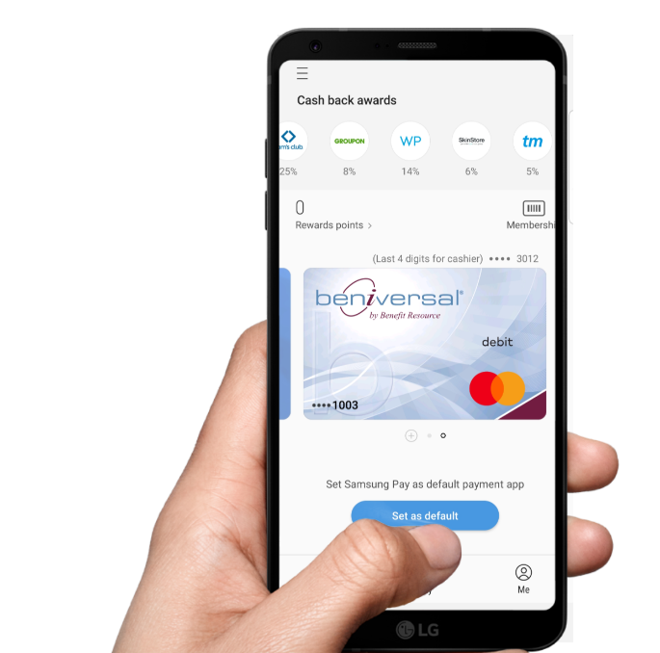
Digital Wallets
Beniversal and eTRAC Prepaid Mastercard are available on:
HOW IT WORKS:
Add Beniversal/eTRAC card to Google Pay, Apple Pay or Samsung Pay If using for transit, Apple Pay and Samsung Pay allow you to update settings to make the Beniversal/eTRAC card the default payment method for transit expenses.
At a contactless terminal, open your digital wallet (Google Pay, Apple Pay or Samsung Pay) on your phone.
Select your Beniversal/eTRAC card as the payment method.
Hold your phone approximately ½ inch away from the terminal.
Terminal will light-up or ding indicating the transaction was successful.
GREAT NEWS! All participants can add cards to digital wallets.
There is no client set-up or participant re-carding required.
Notes:
When it comes to using the Beniversal or eTrac card, you can also load it to your digital wallet in Apple Pay, Google Pay, or Samsung Pay. So, when a contactless terminal is available, you can securely pay for eligible transit or parking expenses by just tapping your phone.
When using your digital wallet on Apple Pay or Samsung Pay for transit expenses, you have the additional option to update your settings to designate your Beniversal or eTrac card as the default payment method.

Slide 12
How Much Should My Election Be?
If using the Beniversal/eTrac Card, be sure to elect the full amount of your mass transit and/or parking expense.
 | PRE-TAX ONLY | POST-TAX (in case you need to contribute more than $315)
MASS TRANSIT EXPENSES: | $104 per month | $335 per month
ELECTION: | $104 per month | $315 per month
DEDUCTION: | $104 per month | $315 (tax-free) + $20 (after tax)
LOADED on card: | $104 | $335
Check out your savings at BenefitResource.com/calculators/cbp-calculator
Notes:
You will want to elect the full amount of your mass transit and parking expenses so the Beniversal or eTrac card can be used to pay for your workplace commuting expenses directly.
If your monthly expenses exceed the IRS monthly pre-tax maximum and your employer supports post-tax deductions for commuter benefits, then the difference will be loaded to your card as after-tax dollars, and you will be able to complete the entire purchase with your Beniversal or eTrac card without having to utilize multiple forms of payment.

Slide 13
Making Elections
All elections and changes must be submitted to your employer. Once an election is made, it will automatically renew each month until you initiate an election change.
You may need to make an election change if:
You have a large balance.
Your workplace commute expenses have changed.
Your fare has increased.
Notes:
To enroll in the Commuter Benefit Plan, you will first need to consult with your employer to determine the method that they have set up for enrolling or making changes to your monthly election. Elections made to the Commuter Benefit Plan are considered evergreen, and will remain the same each month until you initiate a change.
There are several reasons you may choose to change your election, such as an excess balance. In this case, you can either lower your monthly election amount or temporarily set your election to zero to allow you to spend down the excess. Remember to resume the correct election amount about one month before you need the funds in your commuter account. Another reason for needing to update your election amount is if your commuting expenses have changed or if your monthly fares have increased. See your employer for the specific process to update your elections.

Slide 14
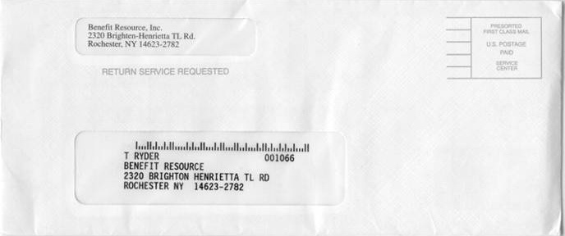
When Will I Get My Card?
You will receive your card toward the end of the month following enrollment.
DO NOT THROW AWAY THIS ENVELOPE - it contains your card!
To activate your card, call the number on the card activation label or login at BenefitResource.com.
Enrollment
Card Received
Benefit Resource, Inc.
245 Kenneth Drive
Rochester, NY 14623-4277
Benefit Resource, Inc.
245 Kenneth Drive
Rochester, NY 14623-4277
Card Activation Instructions
To activate your card: call
(XXX) XXX-XXXX from your home phone.
For additional information, visit BenefitResource.com/resources/card
Notes:
Your Beniversal or eTrac card is mailed to you toward the end of the month following enrollment. The card is mailed in a nondescript envelope from Benefit Resource. So be sure to keep an eye out for this, and read the instructions that are included in your card mailing. To activate your card, you can either call the number on the activation label or log into your BRIWEB account.

Slide 15
Claim Reimbursement Requests
How to Submit
When the Beniversal Card is not used for parking and vanpooling expenses, pay for an eligible expense with another form of payment (e.g., cash, check) and submit a claim for reimbursement.
Submit a reimbursement claim within 180 days of the expense.
Log in to BRIWEB to use the online claim submission tool, or
Use the BRIMOBILE App for iPhone, iPad or Android devices, or
Mail claim forms with appropriate documentation to BRI
Receive your reimbursement by direct deposit or check.
Notes:
If you pay out of pocket for an eligible parking or transit expense without using your Beniversal or eTrac card, you may submit a claim to BRI to be reimbursed from your Commuter account. Keep in mind that you only have up to 180 days from the date you paid for the expense to submit this claim due to IRS regulations,
BRI offers various ways for you to submit your claims, including online through BRIWEB, by using the BRIMOBILE app, or by mailing a claim form to BRI. Reimbursements are processed either by check or by direct deposit.

Slide 16
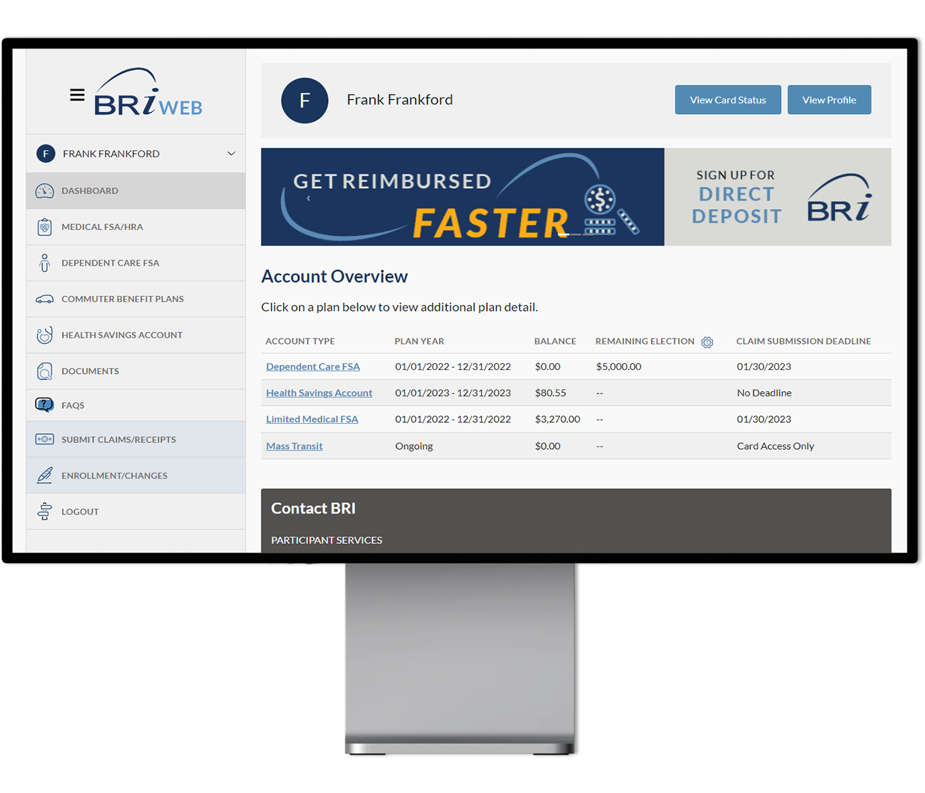
BRIWEB Participant Portal
Review account balance(s) and transactions
Set up direct deposit and balance alerts
Update contact information
Access plan documents and deadlines
…and more!
How to Log In
Go to BenefitResource.com
Click on EMPLOYEE under the Secure Login
If you have not logged in before, choose Register an Account. You will need your Company Code & possibly your Member ID.
Not sure what these are? Check your welcome email!
For additional information, visit BenefitResource.com/resources/briweb
Notes:
Log in to your BRIWEB participant portal to securely review your account balances and transaction details, submit claims, set up direct deposit for faster reimbursement, and more! Access your portal by going to BenefitResource.com to login. Click on the “Employee” login option. The first time you arrive at BRIWEB, you will need to select “Register an Account”.
For registration, you will need the Company Code provided by your employer as well as your first and last name, date of birth, and home zip code. If the system cannot identify you from that information, you will also need to provide your Member ID. This is a unique ID selected by your employer, such as your social security number, employee ID number, or a combination. As part of the registration process, the custom login ID and password you create will be used to access both BRIWEB and the BRIMOBILE app.

Slide 17
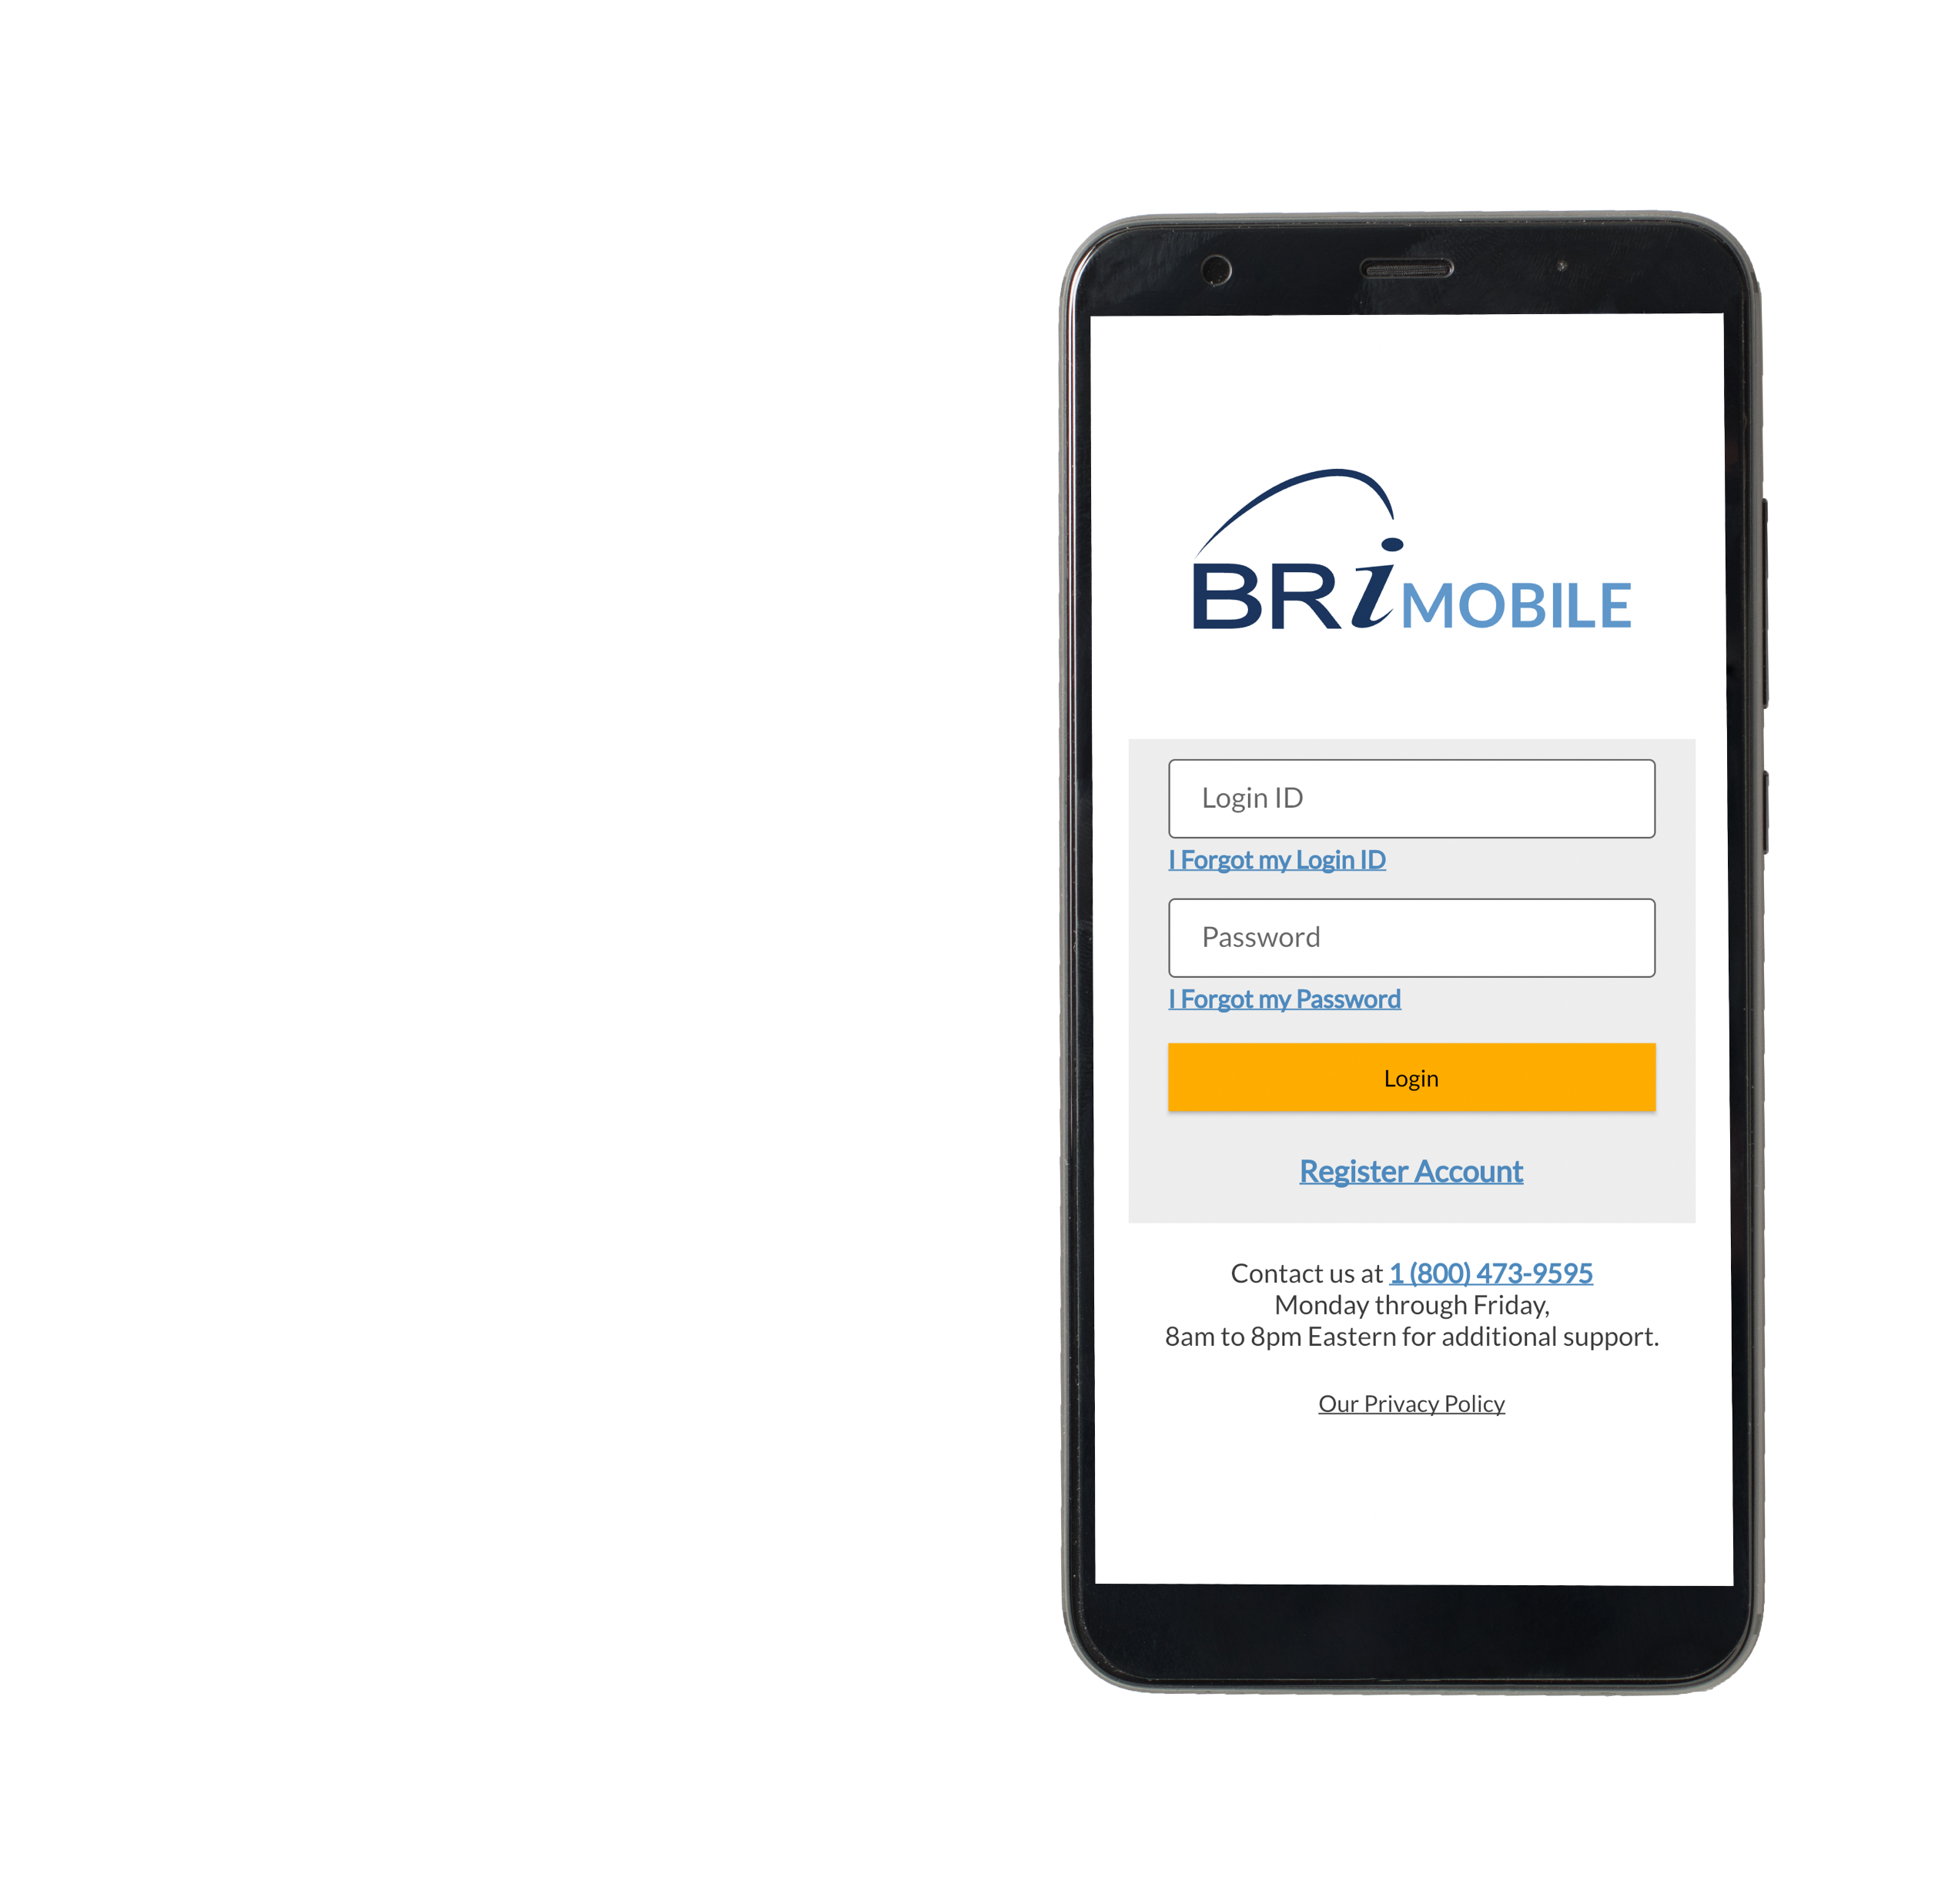
Account Access On-the-Go
Download the BRIMOBILE App for iPhone and Android devices.
Learn more at: BenefitResource.com/resources/brimobile ------
Notes:
The BRIMOBILE app is another great way for you to manage your Commuter Benefit Plan on-the-go. With BRIMOBILE, you can check the balance in your account, view recent transactions, and submit claims. It's a great resource so head over to the Apple App Store or Google Play Store to download it!

Slide 18
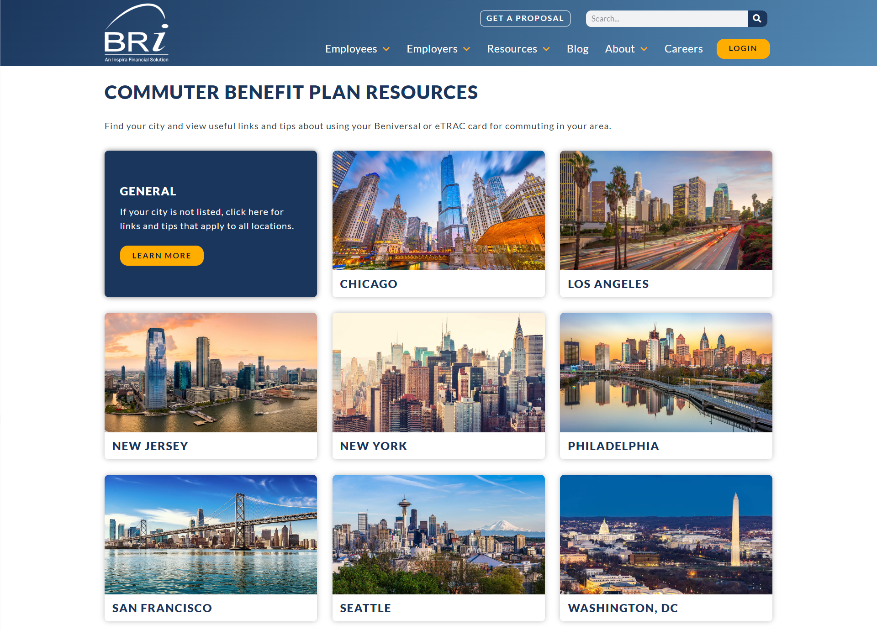
Commuter Resource Center
Access to localized links, tips, and resources for all transit needs!
Find the Commuter Resource Center
Go to BenefitResource.com
Hover over Resources on the main navigation bar
Select Commuter Resource Center under the Participant Resources section.
Notes:
Another great resource available at BenefitResource.com is our Commuter Resource Center. You can learn the best ways to use your account based on your region.

Slide 19
Convenient Participant Support
HOURS:
Monday - Friday, 8am - 8pm (EST)
Support available in English and Spanish
PHONE:
(800) 473-9595
ONLINE LIVE CHAT: BenefitResource.com Available through the BRIWEB employee login
EMAIL:
ParticipantServices@BenefitResource.com
Notes:
And finally, if you ever need assistance with your Commuter Benefit Plan, BRI offers several convenient ways for you to reach out to our Participant Services Department. You can reach us Monday through Friday 8 a.m. until 8 p.m. Eastern Time by phone, via secure online chat in your BRIWEB portal, or by email.

Slide 20
Important Dates to Remember
Initial enrollment through <Enter Date>
First deductions will start on the first paycheck of <Date of First Deductions>
Enrollment and Changes will be permitted on a monthly basis and processed on the 5th of each month
Beniversal Card will arrive by the end of the month following enrollment.
Notes:
The following slide includes some important dates to remember.
The initial open enrollment period is through <Enter Date>
The first deductions will start on the first paycheck of <Date of First Deductions>
Enrollment and Changes will be permitted on a monthly basis and processed on the 5th of each month.
And finally, your Beniversal Card will arrive by the end of the month following enrollment.

