Slide 1
Health Savings Account (HSA)
Benefit Resource, LLC (BRI)
Notes:
Hello. During this presentation, we will cover the details of health savings accounts featuring the Beniversal Prepaid Mastercard.

Slide 2
What is an HSA?
Rules governed by Internal Revenue Code (IRC) Section 223
Pay for out-of-pocket medical expenses with tax-free dollars
HDHP participants can spend funds now or save for retirement
HEALTH SAVINGS ACCOUNT (HSA)
Notes:
Health Savings Accounts, commonly referred to as HSAs, are tax-advantaged IRS-approved health accounts governed by Internal Revenue Code (IRC) Section 223. They are designed to help individuals with high-deductible health plans set aside money to cover qualified medical expenses and save for health expenses in retirement.

Slide 3
Key Advantages of an HSA
FUNDS ROLL OVER year-to-year: No use-or-lose provision
Triple tax benefits: Save on contributions, earnings & withdrawals
EARN INTEREST & INVEST: Provide a supplement to retirement savings
Tax-free withdrawals: Spend tax-free dollars even if coverage ends
YOU own the funds: Keep any funds contributed to the account
1
2
3
4
5
Notes:
There are many advantages to enrolling in an HSA.
First, once a contribution has been made to the account, you own the funds.
HSA funds also rollover from year to year, which means that there is no fear of forfeiting the funds in the account.
HSAs are also the only benefit account to provide a triple tax benefit, which means that you can make tax-free contributions, you can earn interest tax-free, and funds that are withdrawn from the account are also tax free.
Another key advantage is that the funds in an HSA can be invested once a minimum threshold has been met and they can earn interest.
And finally, with an HSA, tax-free withdrawals can be made even if coverage ends including if you are no longer with your employer. So you'll be able to continue to use the funds that have been built up.

Slide 4
HSA Tax Savings Example
TYPICAL ACCOUNT HOLDER
Tom and Sharon have three active daughters, so saving isn’t always easy. They contribute $3,000 annually. After medical expenses, they are typically rolling over $1,000 each year. Since they never know what expenses are around the corner, they keep their funds in a secure bank account earning an average of 2%. See how they benefit:
 | HSA 1-year savings | HSA 5-year savings | HSA 20-year savings
Annual Contribution Total Contribution Annual NET Savings Total NET Savings | $3,000 $1,000 | $3,000 $15,000 $1,000 $5,000 | $3,000 $60,000 $1,000 $20,000
Tax Savings on Contributions | $990 | $4,950 | $19,800
Account Balance (Assumes 2% return) | $1,020 | $5,308 | $24,783
Tax Savings on Earnings | $7 | $762 | $1,578
TOTAL TAX SAVINGS* | $997 | $5,712 | $21,378
*Tax Savings assumes 28% Federal and 5% State tax rates. Figures are intended for illustration purposes only. Actual results may vary.
Notes:
Now, let’s illustrate what the tax savings could look like for a typical account holder. In this example, Tom and Sharon have three active daughters. So saving isn't always easy. They contribute $3,000 annually. After medical expenses, they are typically rolling over $1,000 each year. Since they never know what expenses are around the corner, they keep their funds in a secure bank account earning an average of 2%. So when separated out to demonstrate first-year savings as compared to 5 and 20 year savings, the benefits of an HSA are clear.

Slide 5
HSA Eligibility Requirements
Covered by an HSA-compatible health plan
As defined by the IRS
Not covered by any ineligible coverage
Ineligible coverage includes:
Enrollment in a Medical FSA or HRA.
Enrollment under a spouse’s health plan that is not an HSA-compatible health plan, Medical FSA or HRA.
Not claimed as a dependent on another person’s tax return
Excluding spouse’s
Not enrolled in Medicare
Notes:
To enroll in an HSA and take advantage of those savings, you must meet the eligibility requirements set by the IRS. You must be covered by an HSA compatible high-deductible health plan. You cannot be enrolled in any medical coverage that makes you ineligible, like medical FSA, HRA, or a non-compatible health plan. You can also not be claimed as a dependent on another person's tax return nor enrolled in Medicare.

Slide 6
Contributions
Contributions can be made by you, your employer, or another third-party. The total dollar amount from all parties must adhere to the IRS limits, which are set by the IRS based on your health plan coverage.
Tax-free Contributions
are made through an election in the Cafeteria Plan. This provides you with your maximum tax savings.
After-tax Contributions
can be made until the tax filing deadline and should considered an above-the-line tax deduction on your individual return.
To see the current contribution limits, visit BenefitResource.com/resources/plan-limits
Notes:
Contributions can be made by you, your employer, or another third-party. The total dollar amount from all parties must adhere to the IRS limits, which are set by the IRS based on your health plan coverage. The current limits are available on the Plan Limits page at BeneftResource.com.
Tax-free contributions are made through an election in a cafeteria plan, which provides you with the greatest tax savings. After tax contributions can be made each year until the annual tax filing deadline. These would be listed on your individual tax return an above-the-line tax deduction.

Slide 7
Withdrawals
Withdrawals can be taken any time after the HSA is established, even if you lose HSA-compatible coverage.
There is no time restriction on when you must take a withdrawal for an eligible expense. (No run-out or coverage period restrictions)
You must retain receipts and documentation of eligible expenses. There is no claim adjudication or verification process. It is between you and the IRS.
HSA funds can be used for non-medical expenses. Prior to age 65, normal tax and 20% penalty applies. For ages 65 and older, normal tax applies.
Notes:
You can withdraw funds any time after the HSA is established, even if you lose HSA compatible coverage. You are not restricted by any time frames for withdrawing funds. And while there is no claims adjudication or verification process, you are still responsible for saving all receipts and documentation of eligible expenses. You can even use HSA funds for non-medical expenses. If you do so however prior to the age of 65, normal taxes will apply plus an additional 20% penalty, but for those that are 65 and older only normal taxes apply.

Slide 8
HSA Eligible Expenses
Out-of-Pocket Medical Expenses
OTC Medical Devices & Supplies
OTC Drugs & Medicines
Related Medical Services
Co-payments, deductible expenses, co-insurance, prescription drugs
Dental & vision care, chiropractic care, counseling services
Birth control, first aid supplies, health monitors, insulin & diabetic supplies
Acne, allergy & sinus, cold & flu, pain relief medications
HSA funds may only be used for tax dependents under the age of 19 (or 23 if a full-time student). If your health plan allows a child up to age 26 but they are not a tax dependent, their expenses are not eligible for HSA withdrawal.
Visit BenefitResource.com/resources/eligible for a comprehensive list & lookup tool.
Notes:
Funds can be spent on eligible medical expenses. Examples include any out-of-pocket medical expenses tied to an employer health plan. This includes co-payments, deductible expenses, co-insurance, and prescription drug costs. It also covers other medical services that may not be included in your health plan such as dental, vision, chiropractic, or counseling services. Many over-the-counter items are eligible as well. Some examples of over-the-counter medical devices and supplies that are eligible include birth control, first aid supplies, Health monitors, insulin and diabetic supplies, and more. Some examples of eligible over-the-counter drugs and medicines include acne medications, allergy and sinus medications, cough cold and flu medicines, pain relief medications, and more.
It’s important to note that under an HSA, funds may be used only for dependents who are under the age of 19, or 23 if a full-time student. If your health plan allows a child to the age of 26, but they are not a tax dependent, their expenses are not considered eligible for HSA withdrawal. For a more comprehensive list of what’s eligible as well as an eligible expense lookup tool, visit the Eligible Expenses page at BenefitResource.com.

Slide 9
Filing Your Taxes with an HSA
Forms you will receive from us:
IRS FORM 5498-SA: Reports total account contributions
IRS Form 1099-SA: Reports all account distributions
Form you will receive from your employer:
W-2: In box 12 on your W-2, your employer will report all your tax-free contributions to your HSA (employer and employee).
Form you will need to file with your taxes:
IRS Form 8889: Calculates deductions and eligible withdrawals (if you use tax preparation software, it will ask you a few HSA questions and complete this document for you).
Notes:
If you decide to open an HSA, you will need to report information about your account your taxes. Available from BRI will be IRS Form 5498-SA to report total account contributions, IRS Form 1099-SA to report all account distributions, and other tax information about your account performance throughout the year which you can see from the HSA Management Portal. Available from your employer will be your W-2. In box 12, your employer will report all your tax-free contributions to your HSA. When you file your taxes for the year, you’ll need to file IRS Form 8889 which calculates deductions and eligible withdrawals. If you use tax preparation software, it will ask you a few HSA questions and complete this document for you

Slide 10
Setting Up Your HSA
1
During Open Enrollment, you’ll enroll in the HSA-compatible High Deductible Health Plan (HDHP) and HSA.
Your HSA enrollment is processed, and your identity will need to be verified due to Patriot Act requirements.
The account is established, and you can spend funds as they become available or save them for retirement.
2
3
Notes:
To set up your HSA, you will enroll in the HSA compatible high-deductible health plan and HSA. Your employer will provide instructions for enrolling & the dates enrollment is available. From there, your HSA enrollment will begin to be processed. As a requirement of the USA Patriot Act, your information will be reviewed against an automated ID verification process. If necessary, you may be contacted to provide additional documentation before your account is opened. But once your account is established and has funds in it, you can spend funds as they become available or save them for retirement.

Slide 11
What Should You Contribute?
CONSIDER LIMITS
Employer and third-party contributions need to be considered and counted towards the IRS maximum contribution limit.
ESTIMATE SPEND
It’s recommended that your annual contribution is enough to cover your deductible in case of unexpected expenses.
ADJUST ELECTION
You can make changes to your election once the year has started. Ask your employer how and when changes may occur.
Calculate your savings! Visit BenefitResource.com/calculators/hsa-calculator
Notes:
Now there are some factors to consider when determining your HSA election amount. First, it's important to understand what the contribution limit is and that any employer contributions are counted towards that limit. Next, it's wise to estimate what your expenses may be, and as a rule of thumb, your annual HSA contribution should be enough to cover the deductible in case you have any unexpected expenses. Now keep in mind that funds in the HSA rollover. So there's no need to worry about any risk of losing the funds if they're not used within the plan year. And unlike an FSA, you have the freedom to change your election throughout the year.

Slide 12
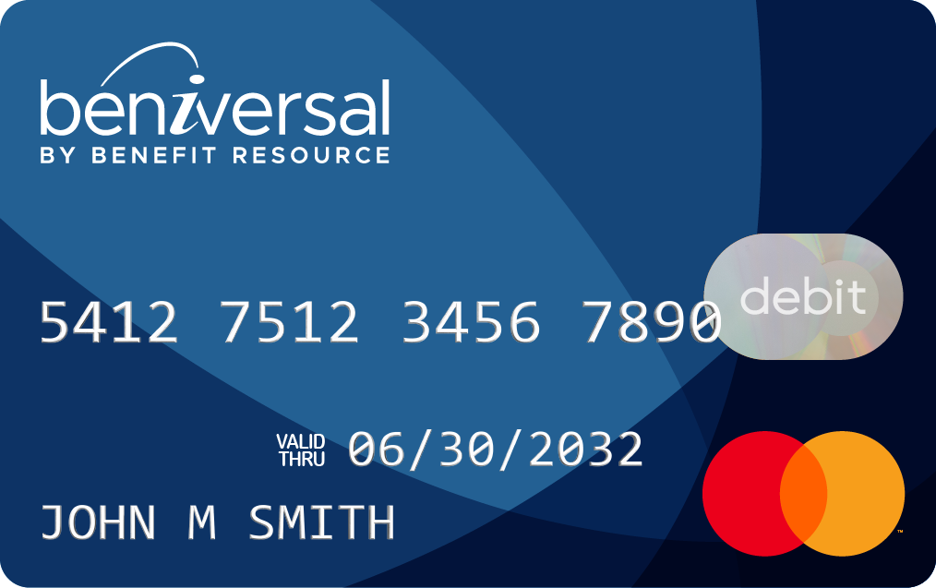
Beniversal Card
Your card will be mailed to your home address in a plain white envelope.
Activate it by calling the number on the activation label or online at BRIWEB.
Be sure to read the instructions on your card carrier.
The Beniversal Prepaid Mastercard is issued by The Bancorp Bank, N.A., Member FDIC, pursuant to a license by Mastercard International Incorporated and may be used for eligible expenses everywhere Mastercard is accepted. Mastercard is a registered trademark, and the circle’s design is a trademark of Mastercard International Incorporated.
To learn more about the Beniversal Card, visit BenefitResource.com/resources/card
Notes:
Upon enrollment, you will receive two Beniversal cards, one for your personal use and one for a spouse or eligible dependent. To activate these cards, you can either call the number on the activation label or log into your BRIWEB account. We encourage you to read the instructions that are included in your card mailing.

Slide 13
Shop the HSA Store
BRI has partnered with HSA Store to provide you with convenient access to over 2,500 HSA-eligible over-the-counter items. You have two ways to shop:
Visit HSAstore.com
Use your Beniversal Card at checkout
Login to BRIWEB
Select the “Shop HSAstore.com” tab.
Notes:
Once your card is activated and funds are available in your account, you can use your card to purchase medical items available through the HSA Store. There are two ways to shop. You can go to HSA store.com and use your Beniversal Card when checking out. Or, you can also take advantage of HSA Direct Pay through BRIWEB. HSA Direct Pay is an integrated payment option that allows you to make purchases directly from BRIWEB.

Slide 14
Qualified Merchants
Qualified healthcare-related merchants (e.g., hospital, doctor, dentist, vision, etc.)
Qualified merchants using inventory identification approval system (IIAS) (e.g., most major drug stores, pharmacies, and major box stores that have a pharmacy department)
Drugstores or pharmacies without inventory identification system (referred to as 90% merchants)
Notes:
Once activated, your Beniversal cards can be used at qualified Merchants. Some examples of qualified healthcare merchants include hospitals, doctor’s offices, and dental and vision providers. You can also use it at qualified merchants using the inventory identification approval system, otherwise known as IIAS. These include most major drug stores and pharmacies or major box stores that have a pharmacy department. The cards can also be used at drug stores or pharmacies without IIAS at Merchants which make at least 90% of their revenue from the sale of eligible medical items, often referred to as 90% merchants. Check out the Eligible Expenses page at BenefitResource.com to learn more.

Slide 15
Doctor & Pharmacy Payments
Provide your health insurance card and receive the service.
Health insurance provider receives the expense and applies network discounts.
Receive an Explanation of Benefits (EOB) and/or a bill.
Pay your health care provider using your Beniversal Card.
WHAT TO EXPECT AT THE DOCTOR’S OFFICE
WHAT TO EXPECT AT THE PHARMACY
Provide your health insurance card to the pharmacy.
Pharmacy processes the prescription and applies network discounts.
Pay the pharmacy using your Beniversal Card.
Receive your prescription.
Notes:
When you visit a doctor's office while covered under an HSA-compatible Health Plan, you should first provide your health insurance card. Your health insurance provider will apply any applicable network discounts, which will be included in your explanation of benefits from your insurance provider and/or a bill from your provider with your amount due. You can pay your bill online with your Beniversal card number. Or you can use another source of payment and reimburse yourself with your HSA by initiating an online transfer. You’ll go through a similar process at a pharmacy: provide your health insurance card, receive any network discounts, then either pay with your Beniversal card or by using another source of payment, and you can then reimburse yourself with your HSA by initiating an online transfer.

Slide 16
Alternate Payment Options
IF YOU DO NOT HAVE ENOUGH FUNDS IN YOUR HSA AT THE TIME OF THE EXPENSE, THERE ARE THREE POTENTIAL OPTIONS AVAILABLE:
Pay With Other Funds
Set Up A Payment Plan
Accelerate HSA Funding
Reimburse yourself by requesting an online transfer to a personal account.
Most doctors’ offices, clinics, and hospitals will work with you.
Ask your employer what options are available with your specific plan.
1
2
3
Notes:
If you don’t have your Beniversal card with you at the time of an expense, you can pay for the expense with another source of payment and reimburse yourself by requesting an online transfer. You can also do this if you do not have enough funds in your HSA at the time of expense – just wait until your balance has built enough to cover the cost. Payment plans are another option. Most doctors’ offices, clinics, and hospitals will work with you. You may also be able to increase or accelerate your HSA funding. Ask your employer what options are available with your specific plan.

Slide 17
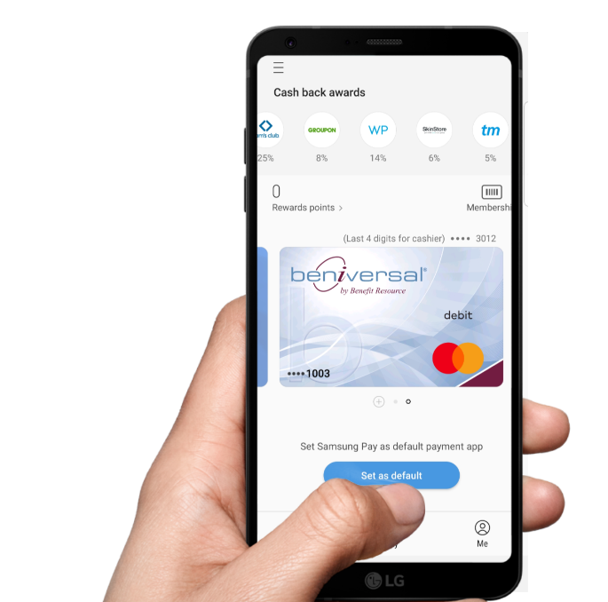
Digital Wallets
The Beniversal Prepaid Mastercard is available on:
HOW IT WORKS:
Add Beniversal card to Google Pay, Apple Pay, or Samsung Pay.
At a contactless terminal, open the digital wallet app on your phone.
Select your Beniversal card as the payment method.
Hold your phone approximately ½ inch away from the terminal.
Terminal will light-up or ding indicating the transaction was successful.
GREAT NEWS! All participants can add cards to digital wallets.
There is no client set-up or participant re-carding required.
Notes:
To make the most of your HSA from BRI, take advantage of the options available with your Beniversal Card – the first being its digital wallet capabilities. You can load your digital wallet into Apple Pay, Google Pay, or Samsung Pay so that when a contactless terminal is available, you can securely pay for eligible HSA expenses through the Beniversal card right from your phone.

Slide 18
FREE Mastercard Services
ID Theft Protection
Protect your personal information: debit/credit cards, SSN, health plan ID numbers, driver’s license, passport, emails, bank accounts, etc.
Identity Theft Alerts
Emergency Wallet Replacement
Access to Certified Resolution Specialists
HEALTHLOCK
Protect your medical data and monitor your medical claims for errors, fraud, and overbilling.
Medical Claim Monitor (FREE)
Medical Claim Auditor (paid with free 90-day trial)
Medical Claim Saver (paid with free 90-day trial)
To learn more and sign up, visit BenefitResource.com/resources/card
Notes:
And thanks to BRI’s partnership with Mastercard, all Beniversal cardholders can take advantage of two additional features, which they can sign up for by visiting the Card page at BenefitResource.com.
First is Mastercard ID Theft Protection. This FREE service, available to all Beniversal Cardholders, scours the Internet for credentials and provides end-to-end, white-glove resolution services to restore consumer identities if stolen. Individuals can add whatever information, cards, and accounts they want monitored – their Beniversal Card, personal credit or debit cards, health, vision, and dental ID numbers, their Social Security Number, driver’s license, passport, bank account numbers, email addresses, and any other personal information they want protected.
Second is HealthLock. HealthLock is a service offered by Mastercard that helps protect cardholders’ medical data and monitors their medical claims for errors, fraud, and overbilling. BRI Beniversal cardholders can have access to HealthLock’s Medical Claim Monitor feature FREE of charge. To receive the Medical Claim Auditor and/or Medical Claim Saver services, an additional monthly fee is required after the initial 90-day trial provided when an individual first signs up. A payment method is required in case you decide to request bill negotiation services.

Slide 19
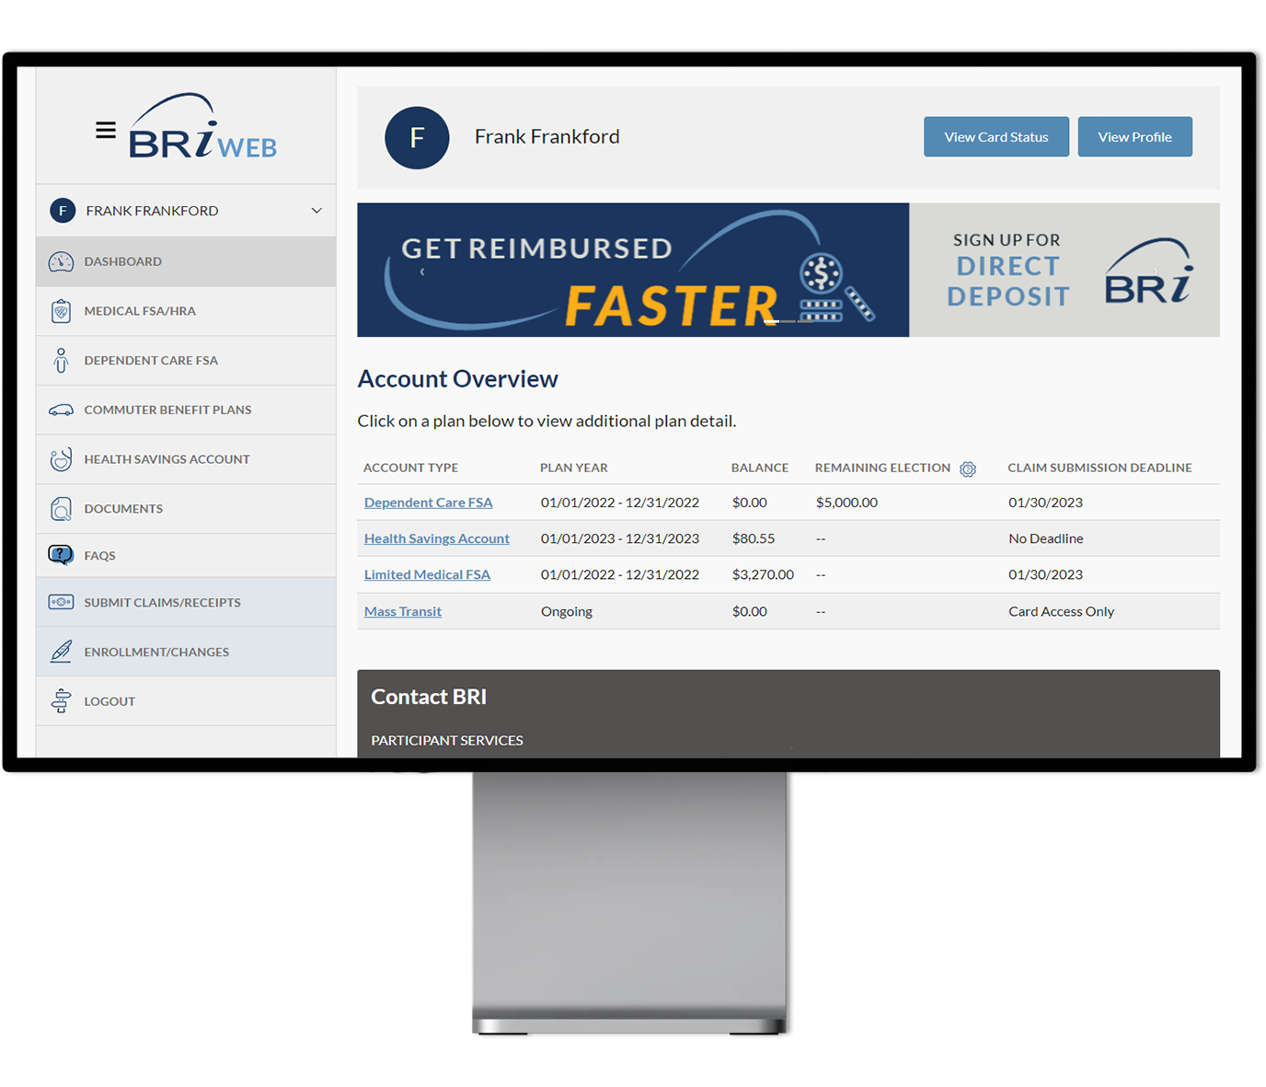
BRIWEB Participant Portal
Review account balance(s) and transactions
Set up direct deposit and balance alerts
Update contact information
Access plan documents and deadlines
…and more!
How to Log In
Go to BenefitResource.com
Click on EMPLOYEE under the Secure Login
If you have not logged in before, choose Register an Account. You will need your Company Code & possibly your Member ID.
Not sure what these are? Check your welcome email!
For additional information, visit BenefitResource.com/resources/briweb
Notes:
BRI provides you with access to a secure BRIWEB participant portal. This site will allow you to review your account balances and transaction details. It is also where you can go to sign up for alerts, set up direct deposit, access your plan documents, and more. You can access the portal by going to benefitresource.com and clicking the login button, then selecting the “Employee” option.
The first time you arrive at BRIWEB, you will need to select “Register an Account”. For registration, you will need the Company Code provided by your employer as well as your first and last name, date of birth, and home zip code. If the system cannot identify you from that information, you will also need to provide your Member ID. This is a unique ID selected by your employer, such as your social security number, employee ID number, or a combination. As part of the registration process, the custom login ID and password you create will be used to access both BRIWEB and the BRIMOBILE app.

Slide 20
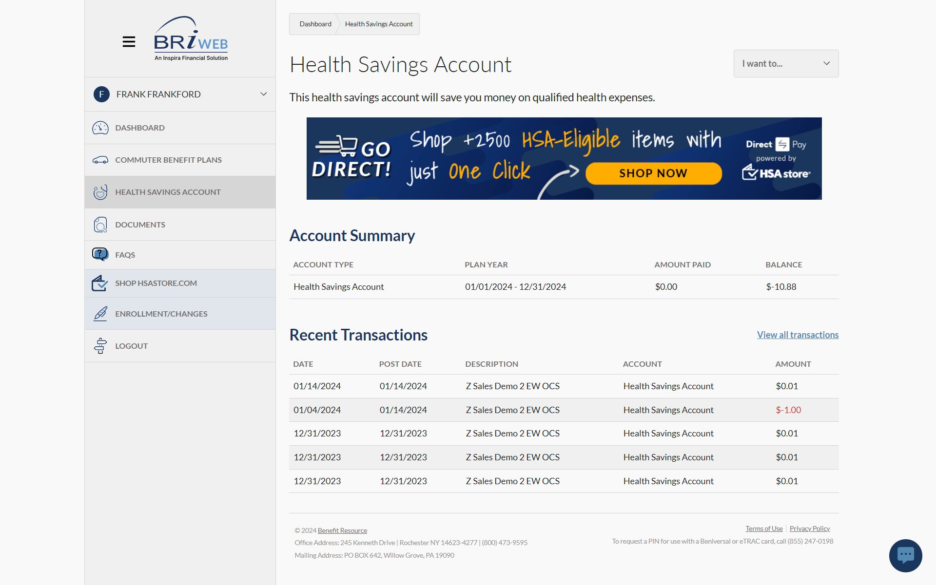
BRIWEB Participant Portal
Use the I want to…
Dropdown to access
additional HSA
management features,
including the HSA Management Portal
Navigate to the
Health Savings Account
tab to view Account Summary and
Recent Transactions
Notes:
To access additional HSA management features, navigate to the Health Savings Account tab from the left sidebar and select the dropdown button in the upper-right corner. There, you’ll have access to additional features, options, and an HSA management portal available through single-sign-on.

Slide 21
HSA Custodial Relationship
UMB Bank is a publicly traded company (NASDAQ: UMBF) headquartered in Kansas City, Missouri. They have been a top HSA Custodian since the mid-1990s.
BENEFIT RESOURCE
THIRD-PARTY HSA administrator
UMB BANK
HSA Custodian
Customer Support
Web Portal & Account Login
Ongoing Communications
Beniversal® Prepaid Mastercard®
Secure FDIC-Insured Account
HSA Management Portal
Fund Management & Investments
Tax Reporting
Investment products are not FDIC insured, are not guaranteed, and may lose value.
Notes:
BRI is partnered with UMB to provide HSA Custodial Services. UMB Bank is a publicly traded company headquartered in Kansas City, Missouri, and has been a top HSA Custodian since the mid-1990s. UMB holds your money in a secure, FDIC-insured account, enables you to manage your funds, and controls your tax reporting documents.

Slide 22
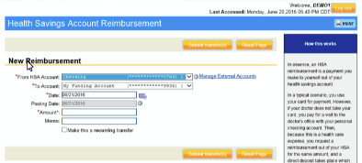
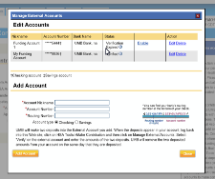
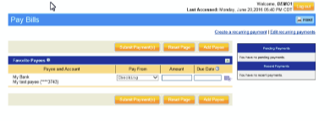
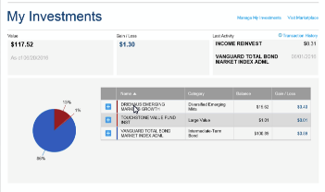
HSA Management Portal
HSA Online Banking
Online Transfers | Pay Bills | View Transactions
HSA e-statements
Edit preferences to “e-statements” to avoid quarterly $1.50 print fee
HSA Tax Information
IRS Form 1099-SA: Provided by Jan. 31
IRS Form 5498-SA: Provided by May 31
Online HSA Tax Information: Cumulative and year-end summary
HSA Investments
Optional –“Best in class mutual fund portfolio” of 33 mutual funds.
$1,000 to invest. Monthly investment fee of $3. No trading fees.
Integrated online investment management with option for monthly automatic sweep to investments.
Investment products are not FDIC insured, are not guaranteed, and may lose value.
Notes:
You’ll use the HSA Management Portal to manage HSA Services. So, online banking features like initiating online transfers, paying bills, viewing transactions. You can access your statements (and while there, update your preferences to be e-statements to avoid the quarterly paper statement fee of $1.50). The information and tax documents you need in order to file your taxes will also be available in the portal. Specifically, IRS Form 5498-SA will be provided by May 31 and IRS Form 1099-SA will be provided by Jan. 31. You will also have a cumulative and year-end summary to assist you in filing your taxes.
And finally, you can manage investments. UMB offers interest-bearing HSA deposit accounts that are FDIC-insured. They also offer the option to invest your HSA funds through a best-in-class portfolio of 33 mutual funds. The minimum balance required to invest is $1,000.

Slide 23
Have an Existing HSA to Transfer?
Option 1:
HSA Trustee-to-Trustee Transfer
Option 2:
HSA Rollover
The IRS permits HSA Rollovers once per 12-months. A rollover is a reportable tax event, but no tax consequences result as long as funds are deposited within 60 days.
Complete the UMB Trustee Transfer Form
Use this option if you intend to:
Close out your other HSA
Send all HSA assets
Have invested HSA funds that will need to be liquidated or transferred
Transfer online or Complete the UMB Hsa Contribution Form
Use this option:
To ensure funds are moved quickly
If you have not already requested a rollover in the last 12-months
To download these forms, visit BenefitResource.com/forms
Notes:
If you are looking to move HSA funds from a prior HSA to your BRI HSA, you can complete either an HSA Trustee-to-Trustee Transfer or an HSA Rollover. The rules and limitations for each are specific, so it is important to understand the differences between these options in order to decide which path works for you.
In an HSA Trustee-to-Trustee transfer, an HSA is moved directly from one HSA Custodian to another HSA Custodian based on a participant’s authorization. To initiate this type of transfer, complete the UMB Trustee Transfer form and send it to the prior custodian to begin processing. This option is good if you intend to close out your other HSA, are sending all HSA assets, and have invested HSA funds that will need to be liquidated or transferred.
There is also an HSA Rollover. Once per 12-months, you are permitted to initiate an HSA Rollover request. With an HSA Rollover, funds are treated as a cash distribution from the prior HSA custodian and must be redeposited as an HSA Rollover to the new custodian within 60 days. A rollover is a reportable tax event, but as long as it is deposited within the required timeframe, it doesn’t result in any tax consequences. You can initiate this type of transfer through the HSA management portal or by completing the UMB HSA Contribution Form. This option helps ensure that funds are moved quickly and can be used if you have not already requested a rollover in the last 12-months.

Slide 24
UMB Bank Fees to Note
A complete list of fees and terms are provided in the Account holder Terms & Conditions, available in briweb.
Description | Fee | How to Avoid
Paper Statements | $1.50 per quarter | Change your preference to e-statements through the HSA Management Portal
Wire Transfers | $10 | Use Online Transfers
Manual Withdrawal Request | $15 | Use Online Transfers
Investment Account Fee (optional service) | $3 per month (no trading fees) | Wait to invest until you fee your balance and earnings are likely to off-set any potential expenses
Notes:
Now there are a few Bank fees to make note of. One is a $1.50 fee for paper statements, which is charged quarterly. However, you can elect to receive electronic statements to avoid this fee. There is a $10 fee for wire transfers and a $15 fee for a manual withdrawals. However, you can avoid these fees by using the online transfer option. And there is a $3 monthly investment fee. However, you may wish to wait to invest until your balance and earnings are likely to offset any potential expenses. A complete list of fees and terms are provided in the Documents section of BRIWEB.

Slide 25
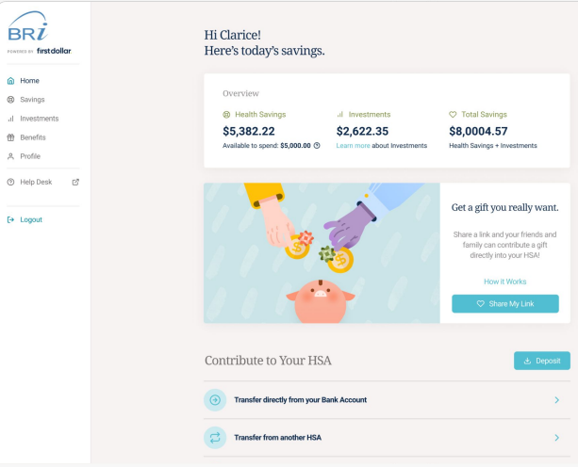
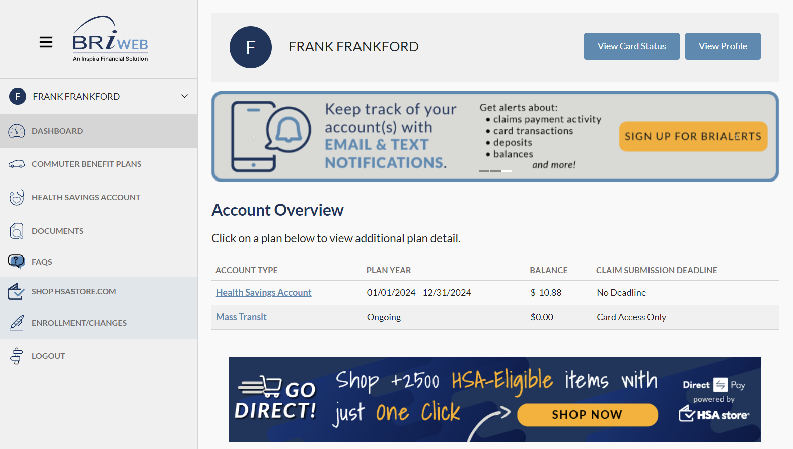
HSA Custodial Relationship
Benefit Resource
HSA Services
Piermont Bank
Customer Support
Web Portal & Account Login
Ongoing Communications
Beniversal® Prepaid Mastercard®
Use “Manage My HSA” to:
Transfer Funds
Access Statements & Tax Documents
Manage HSA Investments
Holds HSA Funds
Secure FDIC-Insured account
Fund Management
Tax reporting
Investment products are not FDIC insured, are not guaranteed, and may lose value.
Notes:
BRI is partnered with a separate HSA Custodian – Piermont Bank – to provide you with a best-in-class interest-bearing HSA deposit account. Piermont Bank holds your money in a secure, FDIC-insured account, enables you to manage your funds, and controls your tax reporting documents.

Slide 26
HSA Management Portal
HSA Online Banking
Online Transfers
Pay Bills
View Transactions
HSA Tax Information
You will receive an email notification when your tax forms are ready
IRS Form 1099-SA: Provided by Jan. 31
IRS Form 5498-SA: Provided by Jan. 31 (or May 31 if making prior year contributions)
HSA Investments
See our walkthrough of the HSA experience: vimeo.com/718804805
Notes:
You’ll use the HSA Management Portal to manage HSA Services. So, online banking features like initiating online transfers, paying bills, viewing transactions. You can access your statements. The information and tax documents you need in order to file your taxes will also be available in the portal. You will receive an email notification when your tax forms are ready. But, you can expect IRS Form 1099-SA and IRS Form 5498-SA to be provided by January 31st. If making prior year contributions, an updated copy of the 5498-SA will be provided prior to May 31. And finally, you can manage investments.

Slide 27
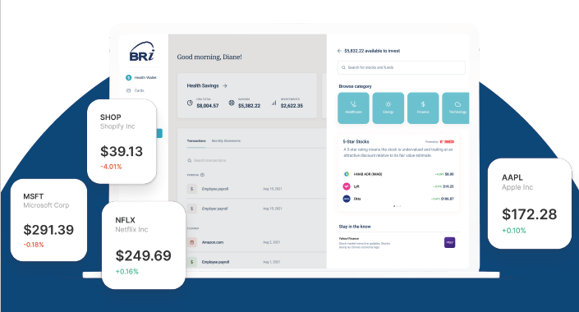
Embedded HSA Investing
INVESTING FEATURES:
No minimum to invest
Invest for a low as $1 per month
Fully embedded experience in the HSA
Desktop and mobile responsive
Fractional shares
CHOOSE FROM:
Select Brokerage
Invest in 500+ top-rated ETFs and individual stocks curated by Morningstar
Managed Funds
Invest in a defined list of up to 30 ETFs curated by Morningstar, rated 3 stars or higher
Automated Investing
Get a personalized investment model underpinned by Morningstar analysis
Notes:
You can invest in over 500 top-rated individual stocks and ETFs curated by Morningstar for as little as $1 per month, with no minimum investment threshold to meet before you can start doing so. Fractional shares and automated investing is available.

Slide 28
Have an Existing HSA to Transfer?
Option 1: HSA Trustee-to-Trustee Transfer
Complete the HSA Trustee-to-Trustee Transfer Form (available pre-populated in BRIWEB or blank from BenefitResource.com/forms)
Use this option if you intend to: (1) Close the HSA, (2) Send all HSA assets, (3) Have invested HSA funds that will need to be liquidated or transferred.
Option 2: HSA Rollover
Once per 12-months, the IRS permits HSA Rollovers. A rollover is a reportable tax event, but as long as it is deposited into a new HSA within 60 days, there are no tax consequences.
An HSA Rollover can be initiated electronically through your BRIWEB account. You will need to link your existing HSA to your new BRI HSA. Then, click Transfer from the HSA management area. Follow the prompts to initiate the Rollover Transfer.
Use this option if : (1) want to ensure funds are moved quickly, and (2) you have not already requested a rollover in the last 12-months.
Notes:
If you are looking to move HSA funds from a prior HSA to your BRI HSA, you can complete either an HSA Trustee-to-Trustee Transfer or an HSA Rollover. The rules and limitations for each are specific, so it is important to understand the differences between these options in order to decide which path works for you.
In an HSA Trustee-to-Trustee transfer, an HSA is moved directly from one HSA Custodian to another HSA Custodian based on a participant’s authorization. Initiate this type of transfer by completing the HSA Trustee-to-Trustee Transfer Form, which is available pre-populated in the Documents section of BRIWEB or blank from the Forms page at BenefitResource.com. This option is good if you intend to close out your other HSA, are sending all HSA assets, and have invested HSA funds that will need to be liquidated or transferred.
There is also an HSA Rollover. Once per 12-months, you are permitted to initiate an HSA Rollover request. With an HSA Rollover, funds are treated as a cash distribution from the prior HSA custodian and must be redeposited as an HSA Rollover to the new custodian within 60 days. A rollover is a reportable tax event, but as long as it is deposited within the required timeframe, it doesn’t result in any tax consequences. An HSA Rollover can be initiated electronically through your BRIWEB account. You will need to link your existing HSA to your new BRI HSA. Then, click “Transfer” from the HSA management area and follow the prompts to initiate the Rollover Transfer. This option helps ensure that funds are moved quickly and can be used if you have not already requested a rollover in the last 12-months.

Slide 29
Bank Fees to Note
Description | Fee
Monthly Maintenance Fee | $0
Minimum Balance Fee | $0
Transfer In/Out fee | $0
Statement Fee | $0
A complete list of fees and terms are provided in the Account Terms & Conditions Available in the documents section of briweb.
Description | Fee | How to Avoid
Dormant Account | $5.00 a month | Avoid with 1 customer-generated activity per 12-months
Manual Check Request | $8.00 | Use online transfers
Daily Overdraft fee | $5.00 a day | Account safeguards limit potential for overdrawing account but always be sure to use BRIWEB to check balance
Notes:
Now there are a few bank fees of note that can easily be avoided. There is a dormant account fee of $5 per month, which you can avoid with 1 customer-generated activity per 12-months. There is an $8 manual check request fee, which can be avoided if you use online transfers instead. And finally, there is a daily overdraft fee of $5 per day. Account safeguards are already in place that limit potential for overdrawing your account, but always be sure to use BRIWEB to check your balance. A complete list of fees and terms are provided in the Account Terms & Conditions Available in the Documents section of BRIWEB.

Slide 30
HSA Custodial Relationship
THIRD-PARTY HSA administrator
HSA Custodian
Customer Support
Web Portal & Account Login
Ongoing Communications
Beniversal® Prepaid Mastercard®
Secure FDIC-Insured Account
HSA Management Portal
Fund Management & Investments
Tax Reporting
Investment products are not FDIC insured, are not guaranteed, and may lose value.
Notes:
BRI is partnered with a separate HSA Custodian to provide you with a best-in-class interest-bearing HSA deposit account. An HSA custodian is an entity that holds your money in a secure, FDIC-insured account, enables you to manage your funds, and controls your tax reporting documents. There may be separate fees charged by your custodian. A complete list of fees and terms are provided in the Documents section of BRIWEB.

Slide 31
HSA Management Portal
Use the I want to…
Dropdown to access
additional HSA
management features,
including the HSA Management Portal
HSA Online Banking
Online Transfers
Pay Bills
View Transactions
HSA Tax Information
IRS Form 1099-SA
IRS Form 5498-SA
HSA Investments
Investment products are not FDIC insured, are not guaranteed, and may lose value.
Notes:
You’ll use the HSA Management Portal to manage HSA Services. So, online banking features like initiating online transfers, paying bills, viewing transactions. You can access your statements. The information and tax documents you need in order to file your taxes will also be available in the portal. And finally, you’ll be able to invest your HSA funds through a curated selection of top-rated options once you reach the minimum balance required by the custodian.

Slide 32
Have an Existing HSA to Transfer?
Option 1:
HSA Trustee-to-Trustee Transfer
Option 2:
HSA Rollover
The IRS permits HSA Rollovers once per 12-months. A rollover is a reportable tax event, but no tax consequences result as long as funds are deposited within 60 days.
Use this option if you intend to:
Close out your other HSA
Send all HSA assets
Have invested HSA funds that will need to be liquidated or transferred
Use this option:
To ensure funds are moved quickly
If you have not already requested a rollover in the last 12-months
Notes:
If you are looking to move HSA funds from a prior HSA to your BRI HSA, you can complete either an HSA Trustee-to-Trustee Transfer or an HSA Rollover. The rules and limitations for each are specific, so it is important to understand the differences between these options in order to decide which path works for you.
In an HSA Trustee-to-Trustee transfer, an HSA is moved directly from one HSA Custodian to another HSA Custodian based on a participant’s authorization. This most commonly requires a physical form to be completed and sent to the prior custodian to begin processing. This option is good if you intend to close out your other HSA, are sending all HSA assets, and have invested HSA funds that will need to be liquidated or transferred.
There is also an HSA Rollover. Once per 12-months, you are permitted to initiate an HSA Rollover request. With an HSA Rollover, funds are treated as a cash distribution from the prior HSA custodian and must be redeposited as an HSA Rollover to the new custodian within 60 days. A rollover is a reportable tax event, but as long as it is deposited within the required timeframe, it doesn’t result in any tax consequences. This option helps ensure that funds are moved quickly and can be used if you have not already requested a rollover in the last 12-months.

Slide 33
Convenient Participant Support
HOURS:
Monday - Friday, 8am - 8pm (EST)
Support available in English and Spanish
PHONE:
(800) 473-9595
ONLINE LIVE CHAT: BenefitResource.com Available through the BRIWEB employee login
EMAIL:
ParticipantServices@BenefitResource.com
Notes:
And finally, if you ever need assistance with your HSA, BRI offers several convenient ways for you to reach out to our Participant Services Department. You can reach us Monday through Friday 8 a.m. Until 8 p.m. Eastern Time by phone, via online chat at BRIWEB, or by email.

Slide 34
Important Dates to Remember
Open enrollment:
<Start Date> to <End Date>
You must enroll in an HSA-compatible health plan:
Enter HSA-compatible plan(s) that are being offered
Employer Contribution Amounts:
Single Coverage: <Enter annual amount and frequency>
Family Coverage: <Enter annual amount and frequency>

